Slide 1
KNOT's Not Only Terminal
Team Nice Penguin

Slide 2






Team Nice Penguin
Minwoo, Cho
Seokhyeon, Yun
TOM
Team Leader Front-end : Console/Reference Back-end : SSH Console
Team Member Front-end : Home
Team Member Front-end : About

Slide 3
Requirement Analysis
Functional Requirement
1. SSH Console
- Users can access their own server via using SSH Protocol
- Users can send LINUX commands via using input text bar
- Users can send LINUX commands via using buttons
- Buttons need to contain frequently required linux commands
2. LINUX Reference
- This page needs to contain general linux commands
- This page needs to classify linux commands via their own subjects
Non- Functional Requirement
1. Home
- This page needs to show about SSH Console of this project's information
- This page needs to show about SSH Protocol and LINUX's information
- This page needs to show technical stacks that used in this project
2. About
- This page needs to show about this project's name
- This page needs to show pictures about using this project
- This page needs to show about this project's team and each member's information
- This page needs to show about where the project's team is

Slide 4
SSH Web Console
LINUX Reference
The main production goal of this project is to make it available on the web without the need to install additional programs for SSH communication. In addition, we implemented a system to automatically enter commands by pressing a button instead of just typing commands.
To make it easier for the average user, we've put together a reference that covers basic Linux command usage. It's presented in a tabular format, so it's easy to recognize at a glance and shows groups of commands used in similar situations.
Overview
KNOT's Not Only Terminal
Named in old hacker style, this project offers users a new kind of web SSH terminal.

Slide 5
Single Page Application
HOME
Console
Reference
About
Our page consists of a single piece of HTML, not several separate pieces of HTML.
We used a combination of appropriate JavaScript and display in CSS to ensure that it doesn't take too much time to load during use.
In one HTML
The backend configuration utilized Node.js, while the frontend configuration utilized React, Bootstrap, and Javascript.

Slide 6
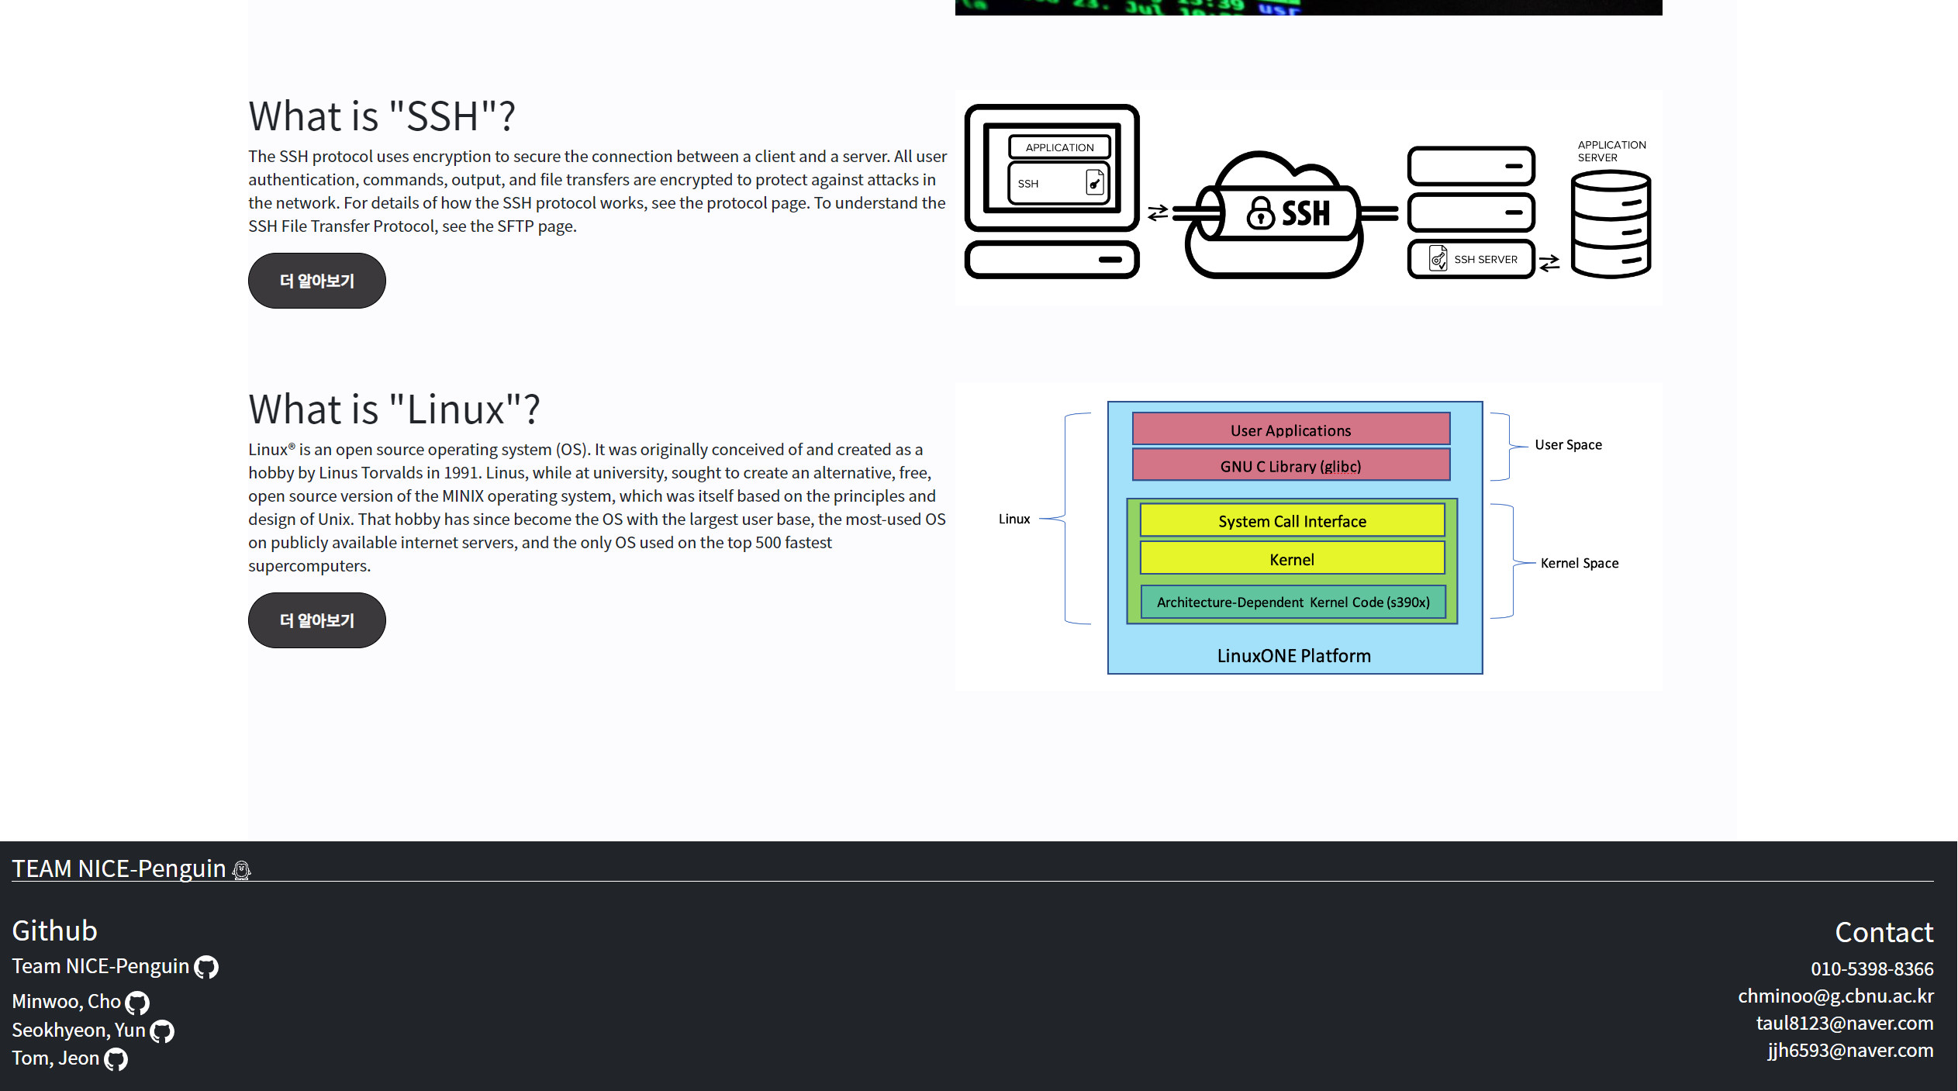
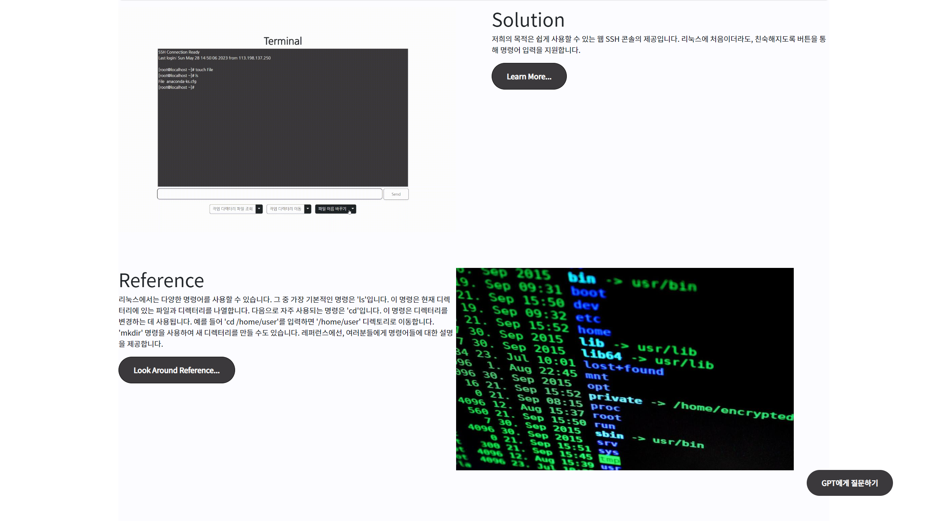

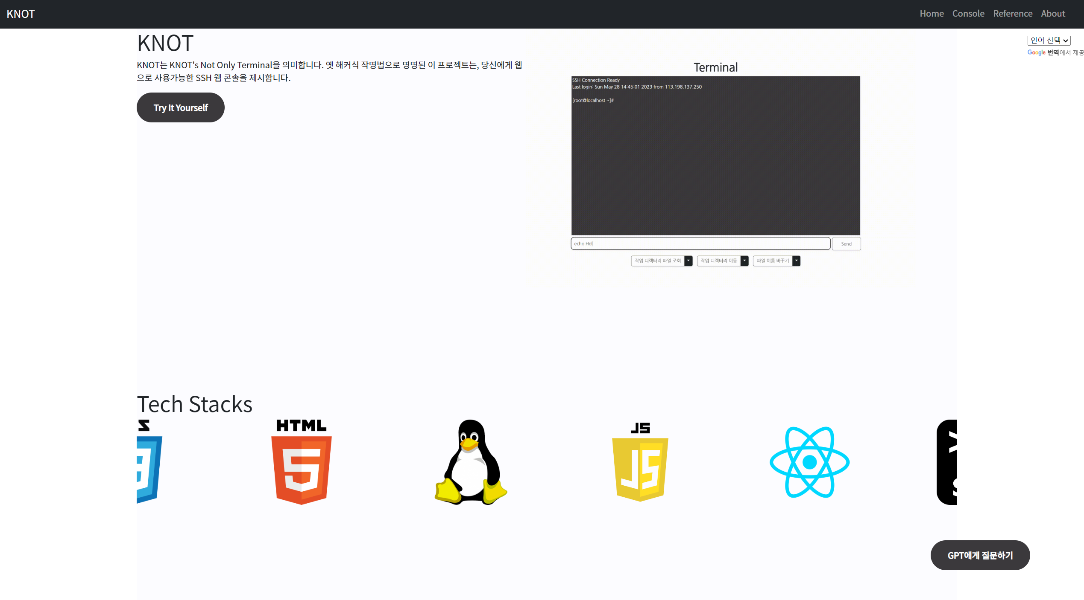
Home
We offer information of our Web Console, Tech Stack
Displays some information when scroll down
And gives detail information about our pages
...and about SSH, LINUX!

Slide 7
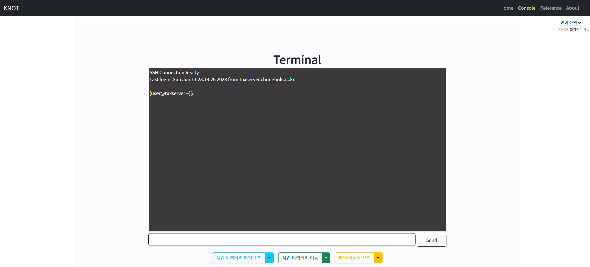
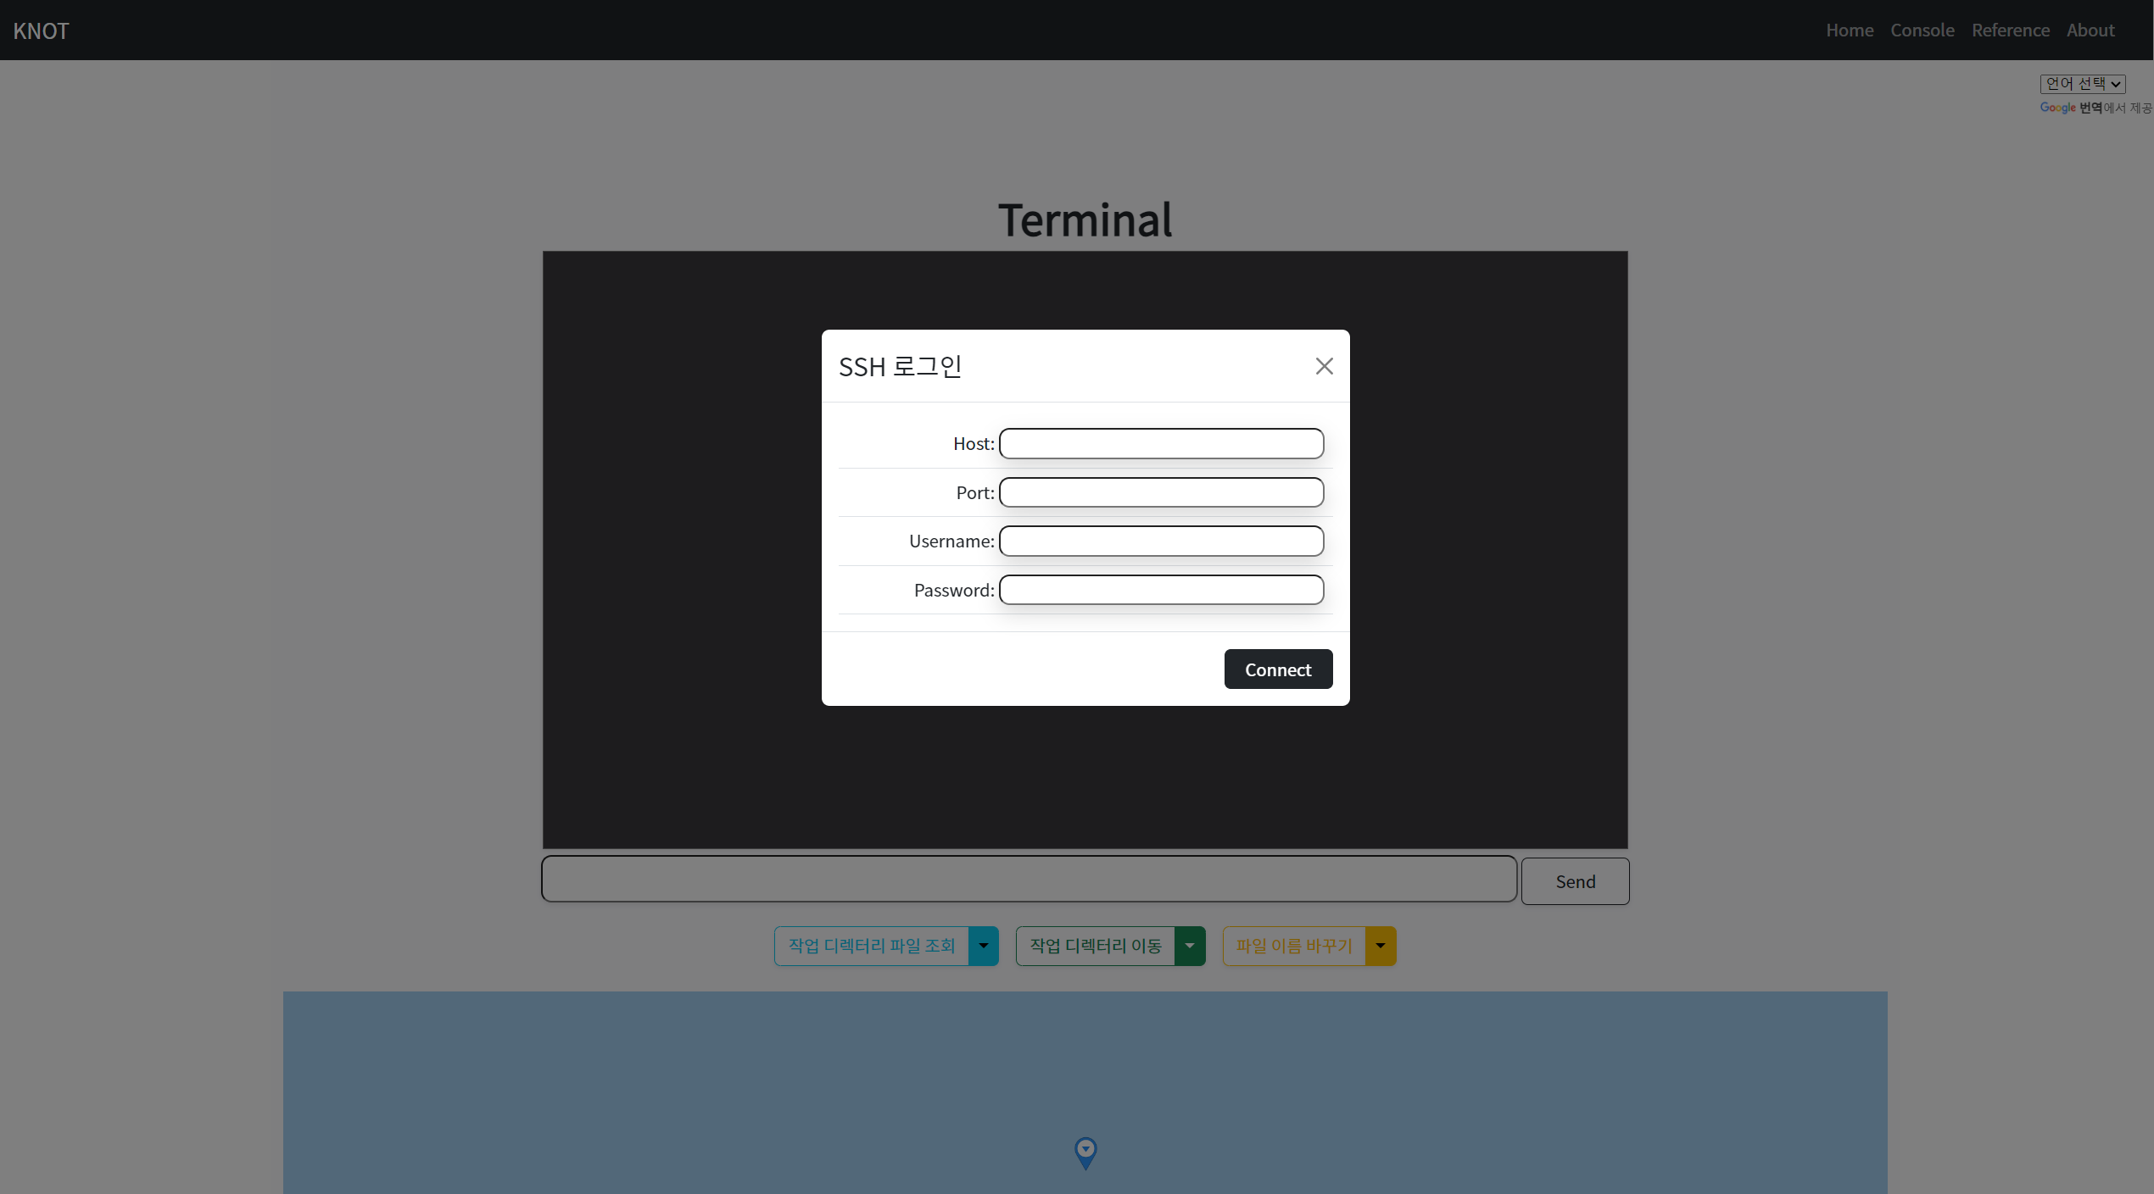
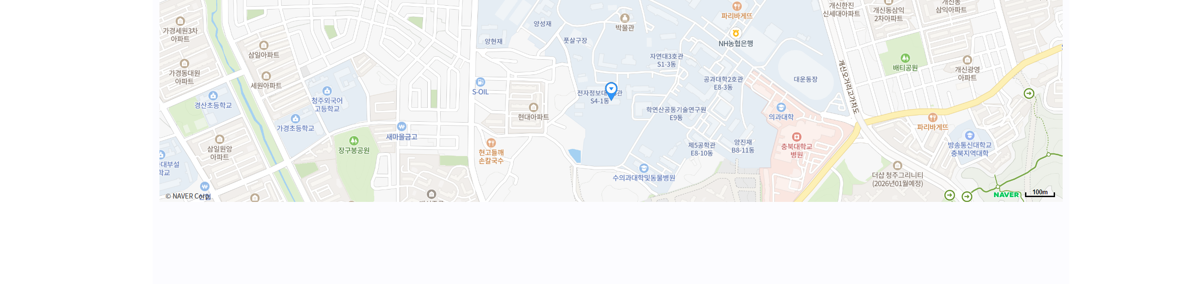
Console
You can type your SSH server address and port, username, password
You can use command via typing or click button
and can see where the server is!

Slide 8
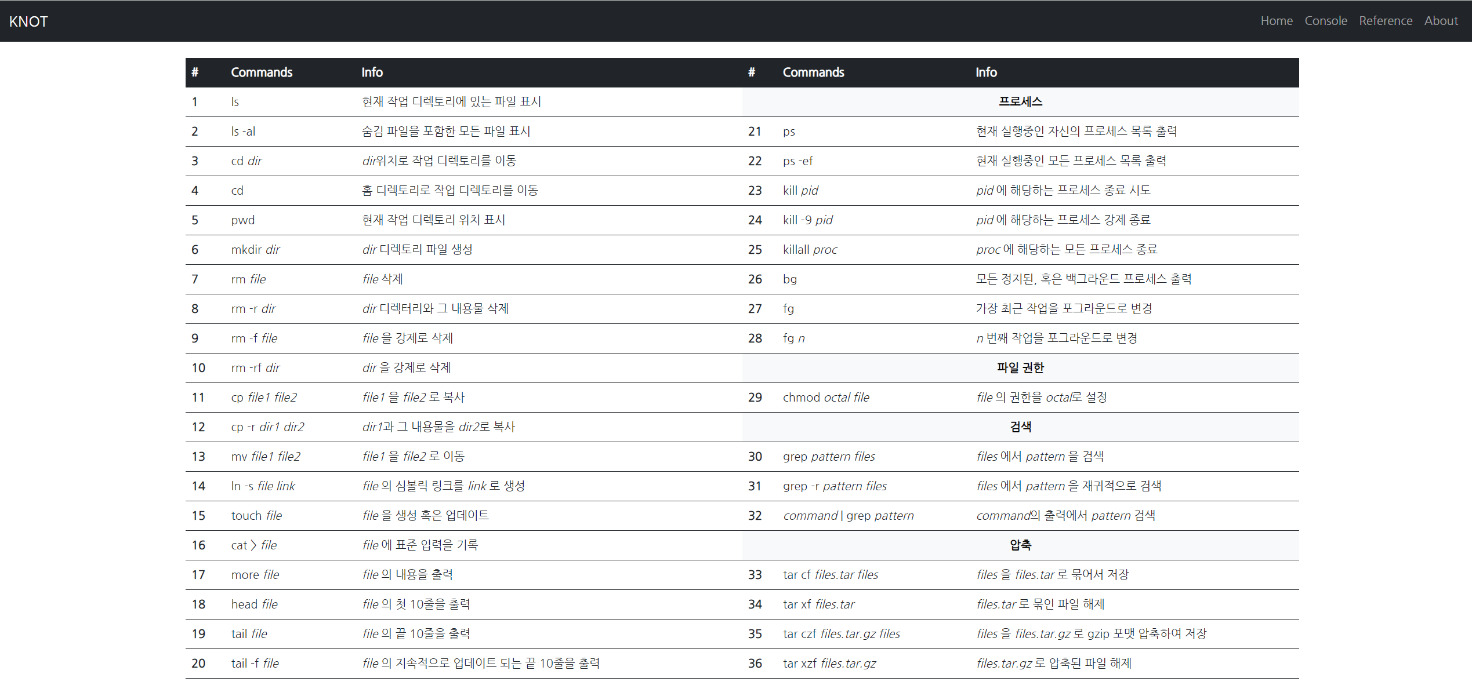
Reference
This shows the basic commands available in Linux. Users can utilize them to access the SSH web console.

Slide 9
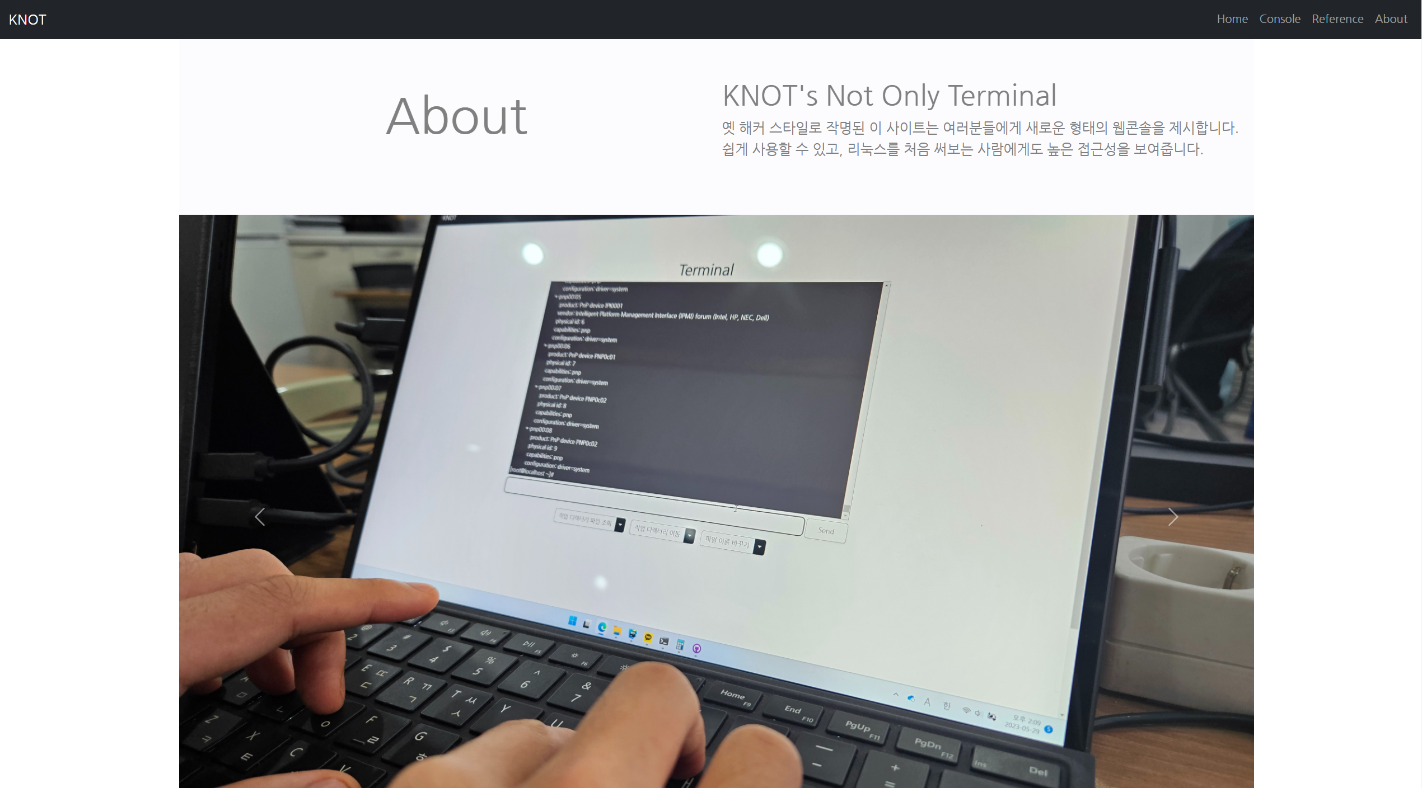
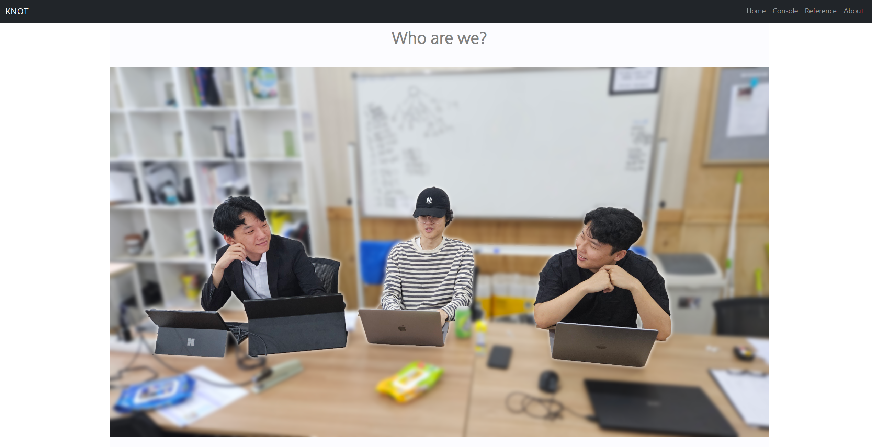
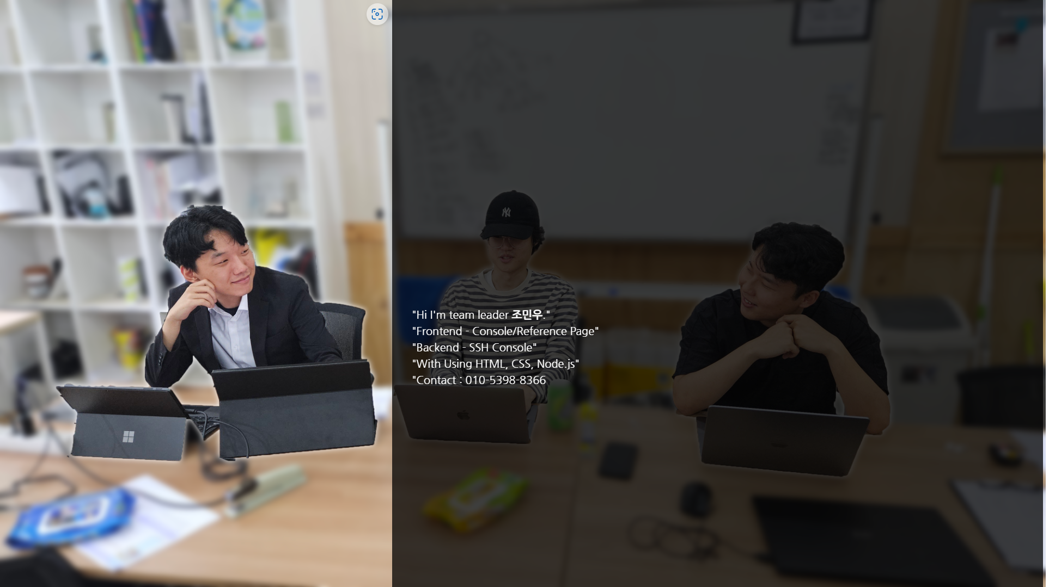
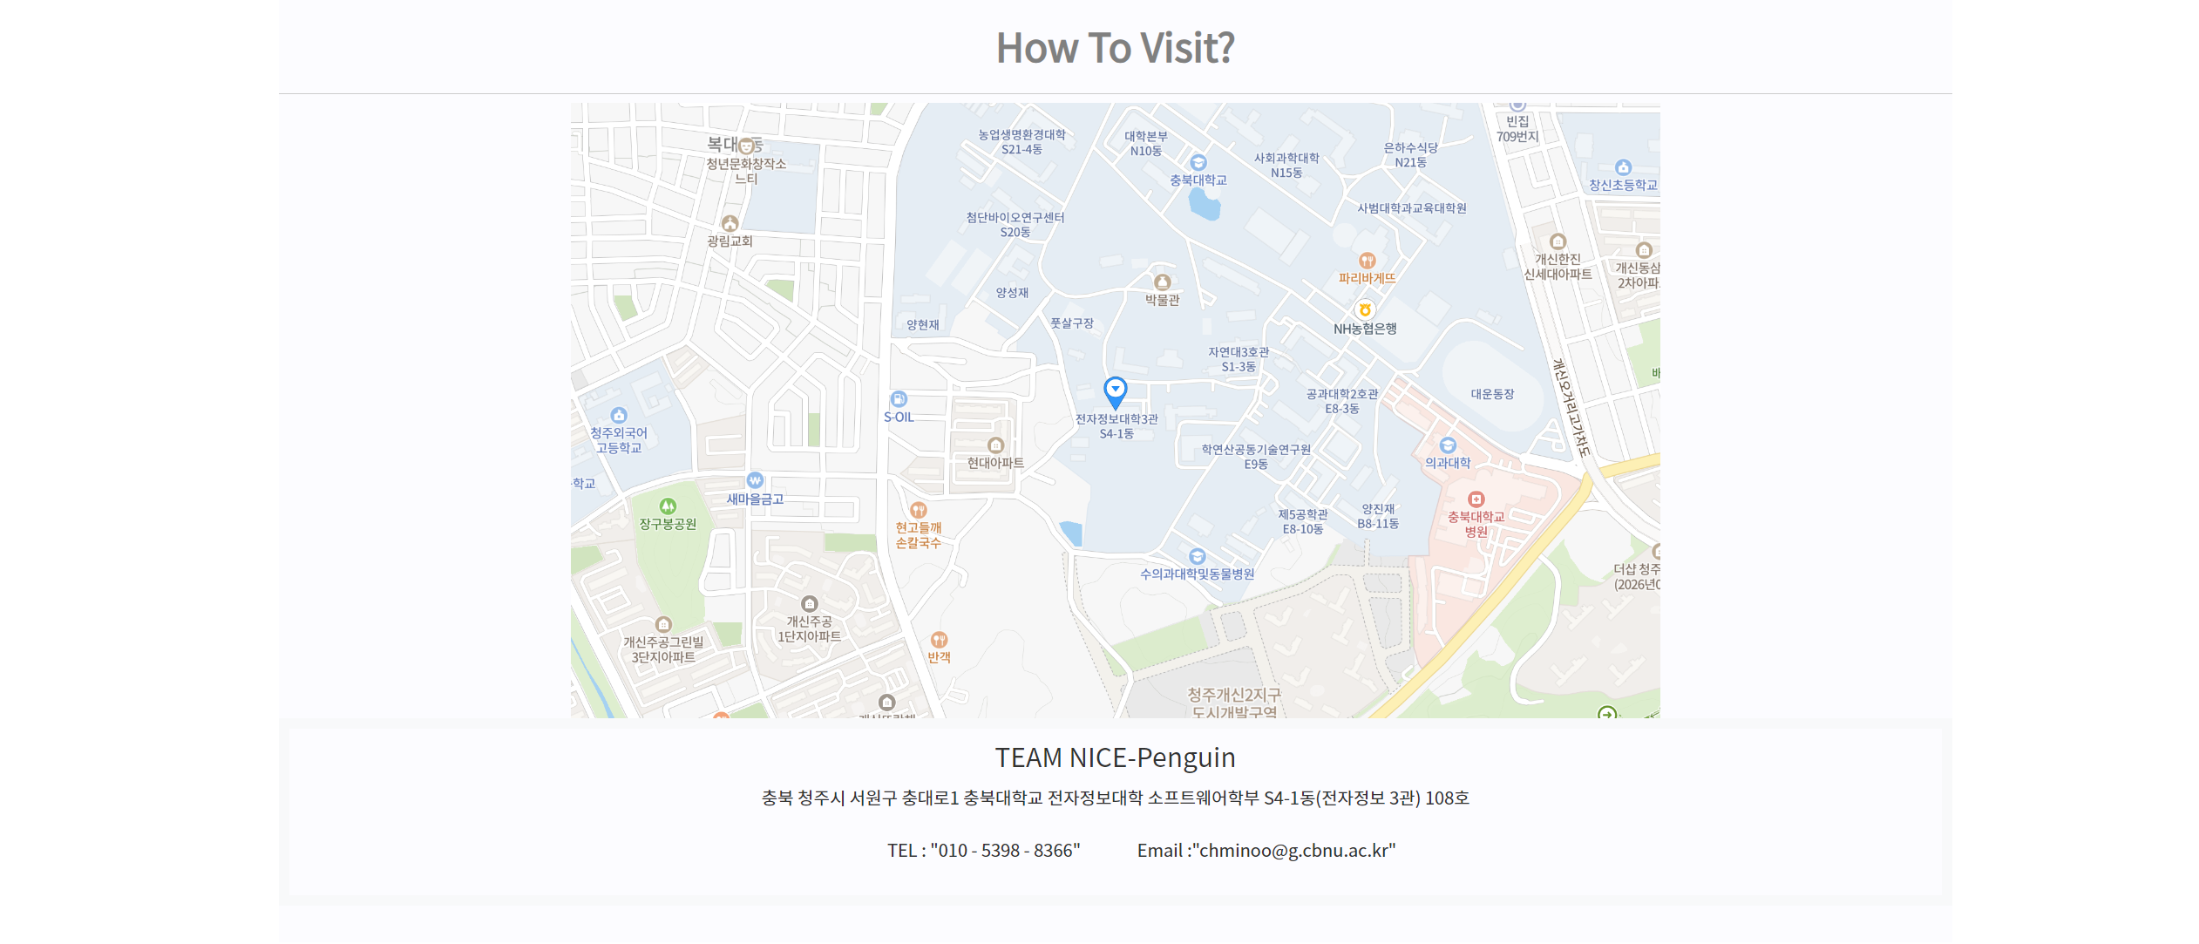
About
We display the semantics of our project.
And there's our team description
...with some detatil description each member
And our location!

Slide 10





Front-End Technical Stack
Home
Console
1. React
2. SASS
3. JavaScript
1. HTML
2. CSS
3. JavaScript
Reference
About
1. HTML
2. CSS
3. JavaScript
1. HTML
2. CSS
3. JavaScript

Slide 11




Back-End Technical Stack
SSH Console
Server
Node.JS
- CORS
- Express
- Socket.io
- SSH2
Server based on Cent OS 7
Http host using NGINX
Security system using Firewalld

Slide 12

GitHub
KNOT's Not Only Terminal
URL : http://tuxserver.cbnu.ac.kr
Project Repository
https://github.com/Nice-Penguin/KNOT
hyun-sa(Minwoo, Cho)
https://github.com/hyun-sa
taul8123(Seokhyun, Yun)
https://github.com/taul8123
jjh6593(Tom)
https://github.com/jjh6593

Slide 13
Thank you!
KNOT's Not Only Terminal
Named in old hacker style, this project offers users a new kind of web SSH terminal.
Is There Any Question?

